Slide 1
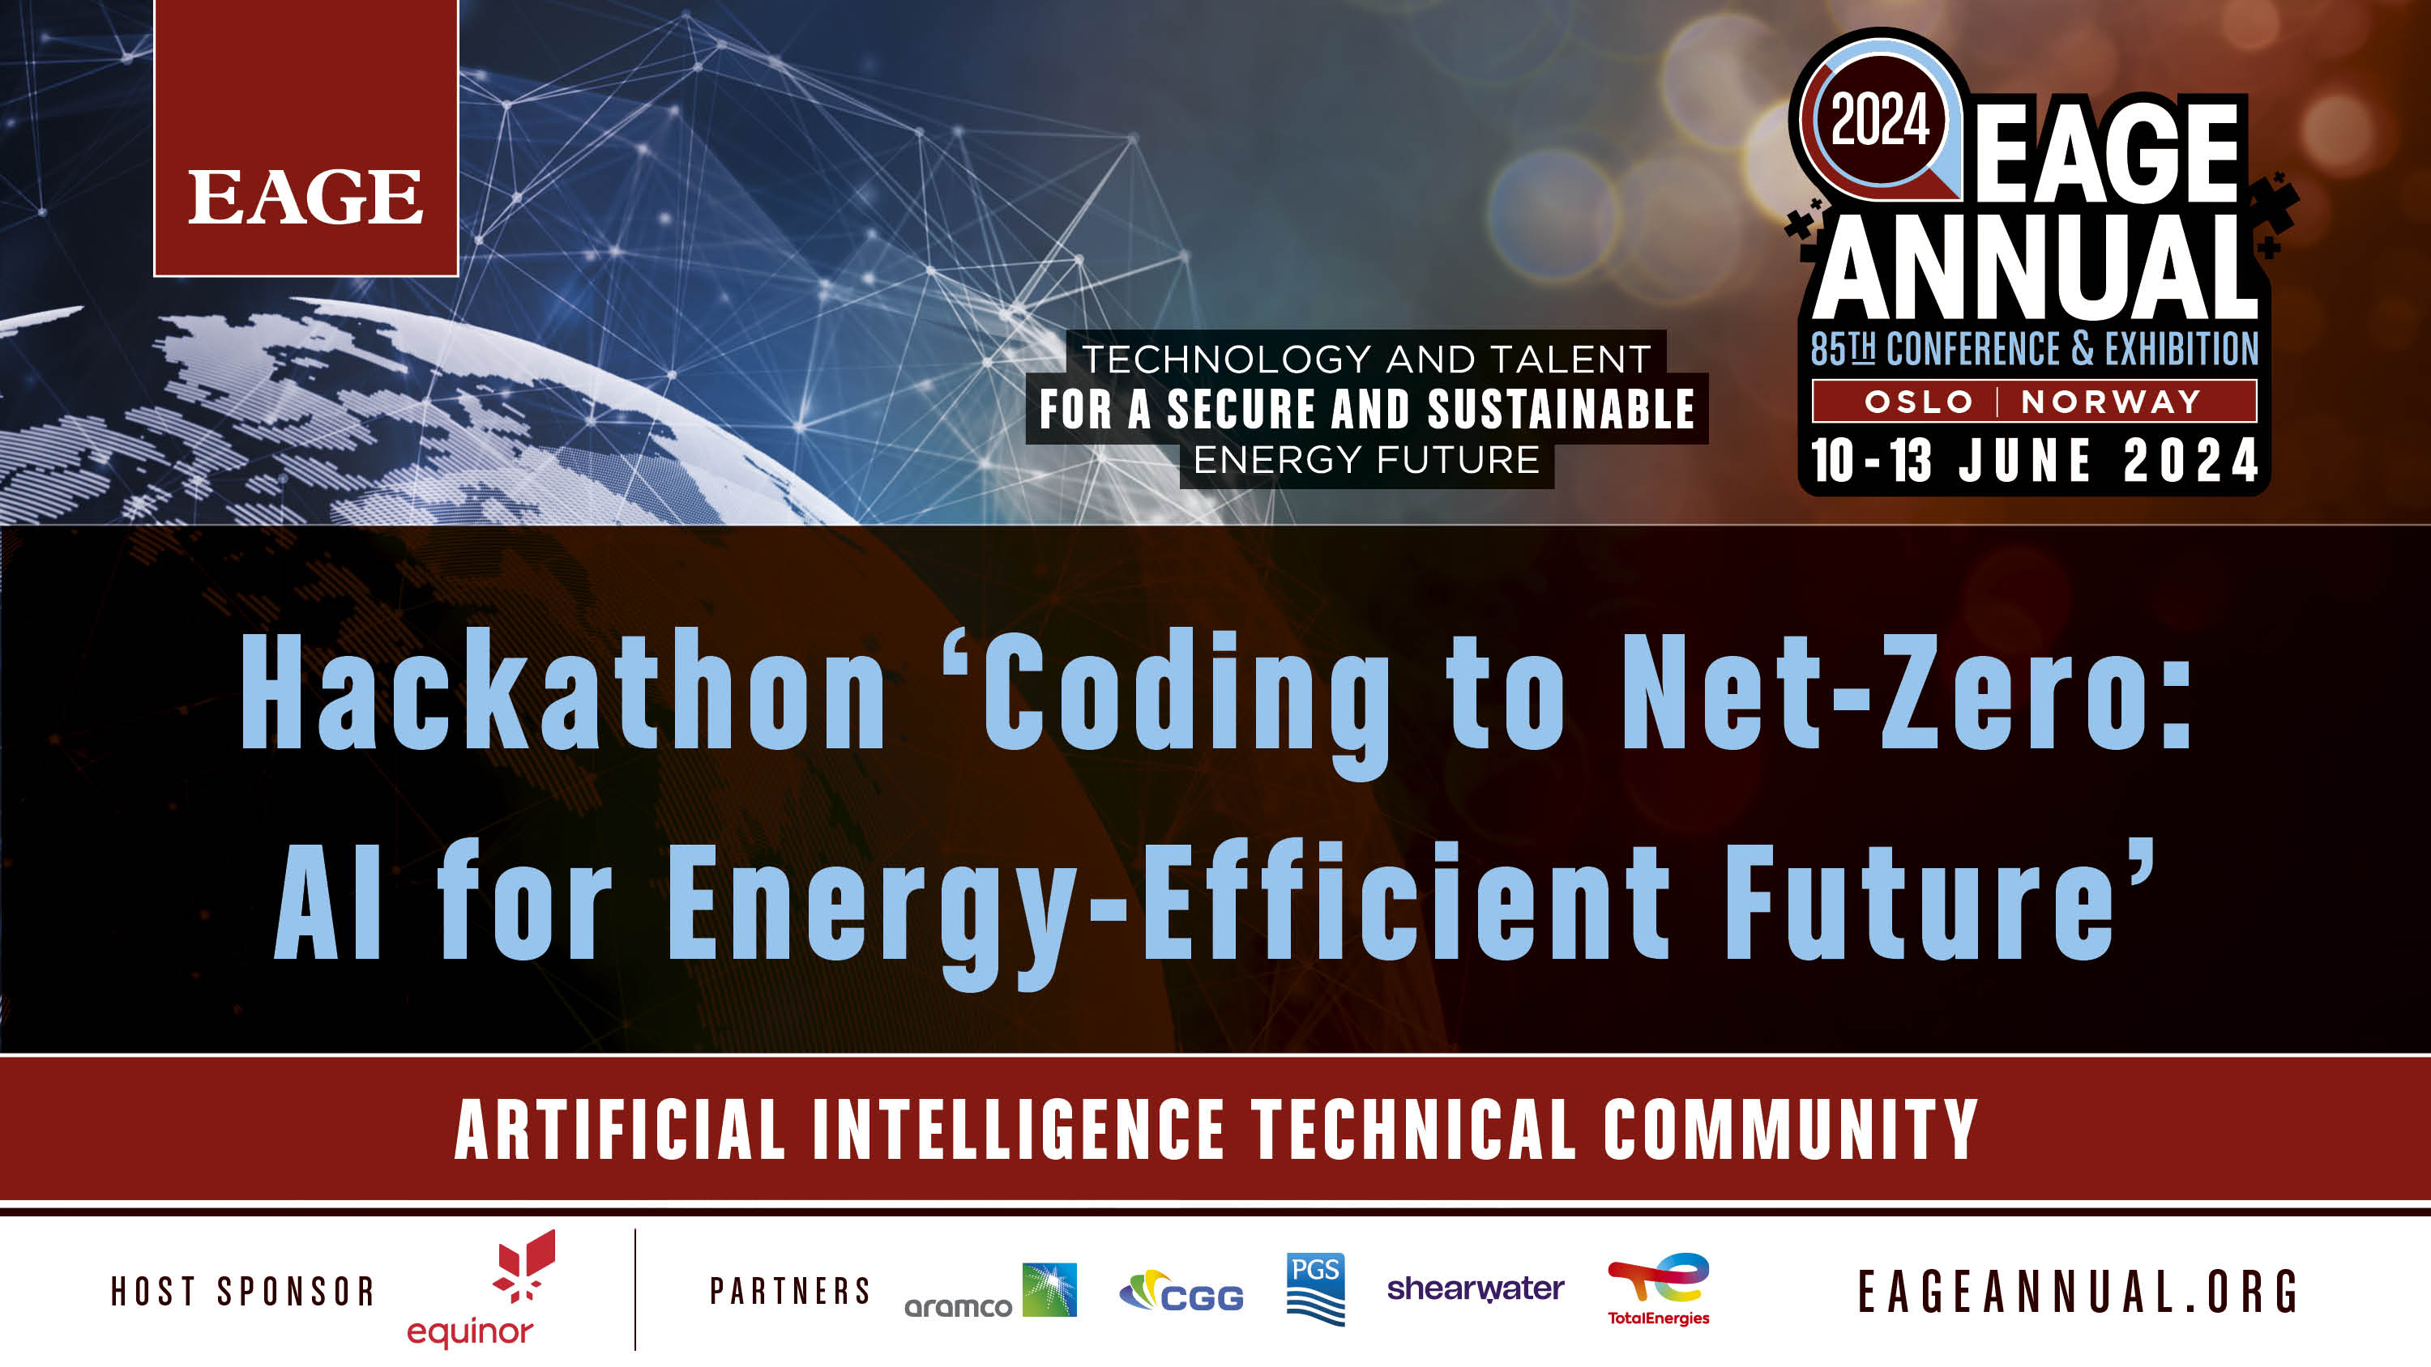

Slide 2

Thank you to our sponsors who made this possible!

Slide 3
Photography and recording
Disclaimer – if you do not want your photo taken in person during this hackathon, please speak to a facilitator asap.
Are we recording anything this year?

Slide 4
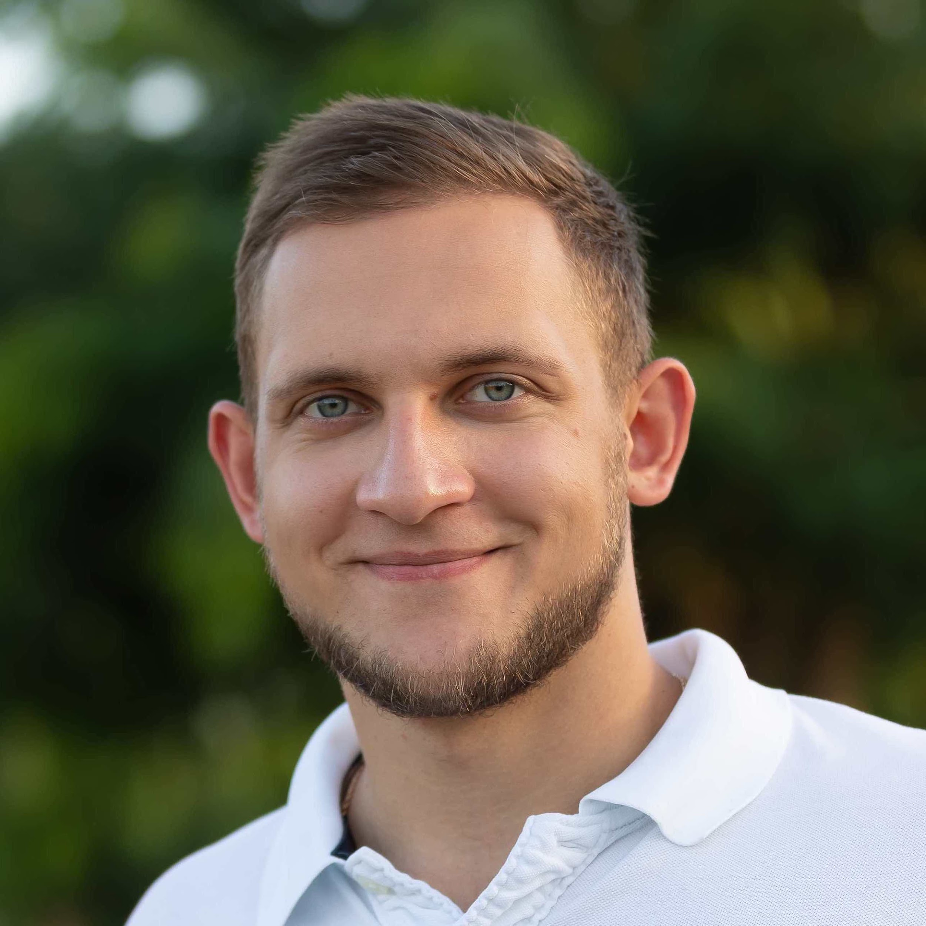
Meet your facilitators – Oleg, Issam and Clement
Oleg Ovcharenko (NVIDIA)
Oleg is Solutions Architect for Energy at NVIDIA. He received his Ph.D from KAUST where he was exploring data-driven methods for the initialization of full-waveform inversion. Oleg is broadly interested in HPC and deep learning applications in geophysics.

Slide 5
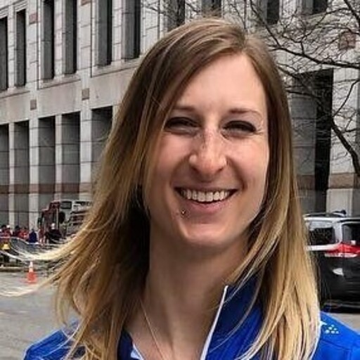
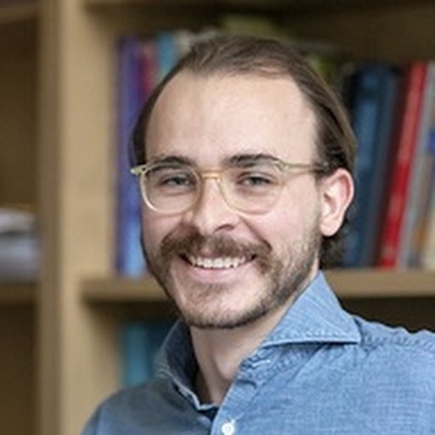
Meet your facilitators – Ashley and Lukas
Ashley Russell (Equinor ASA)
Leader for Data Science and Analytics for subsurface in Equinor. Geologist, self taught data scientist, expertise in Python, data visualization, including interactive plotting and dashboarding, statistics, and machine learning.
@ashleyr (softwareunderground) aruss@equinor.com
Lukas Mosser (Aker BP ASA)
Lukas Mosser is an Advanced Data Scientist at Aker BP. He currently leads Aker BPs efforts around conversational AI. Lukas received his P.h.D from Imperial College London, where he worked on stochastic reconstruction of porous media and geophysical inverse problems using deep learning. He currently also serves as a member of the EAGE AI committee.
@porestar (twitter) @lmoss (softwareunderground) lukas.mosser@akerbp.com

Slide 6

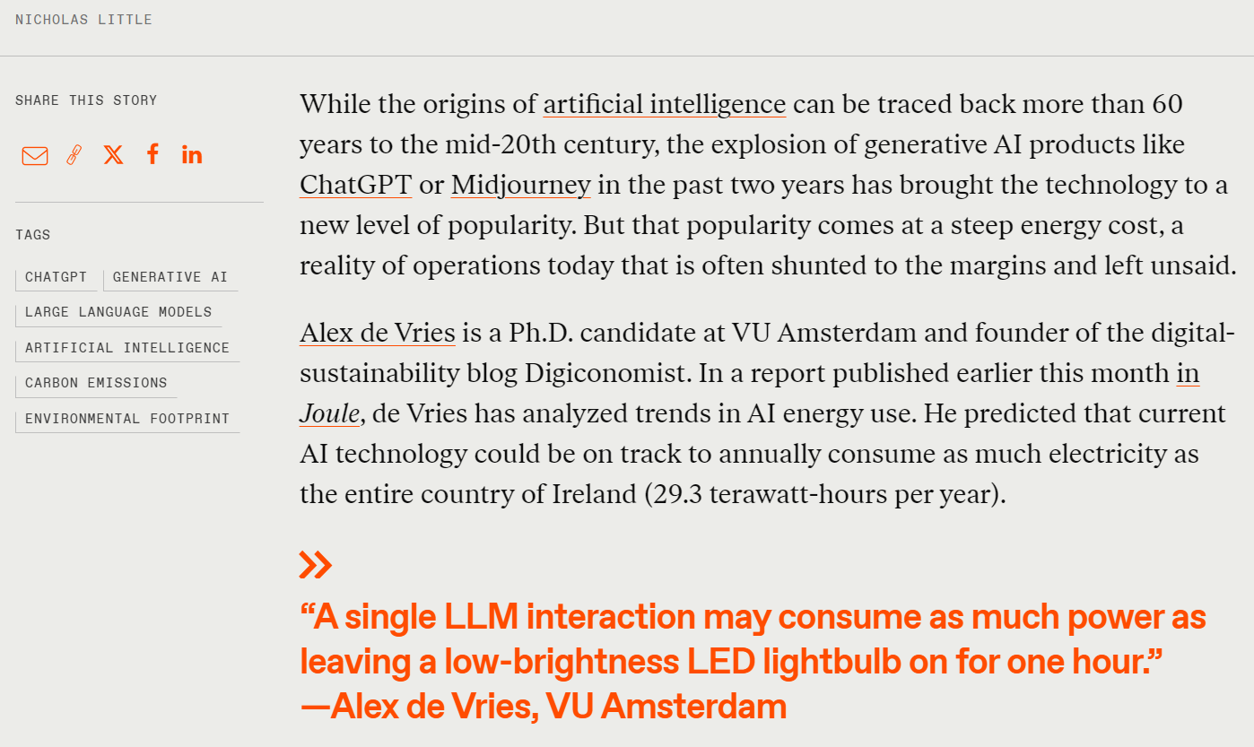
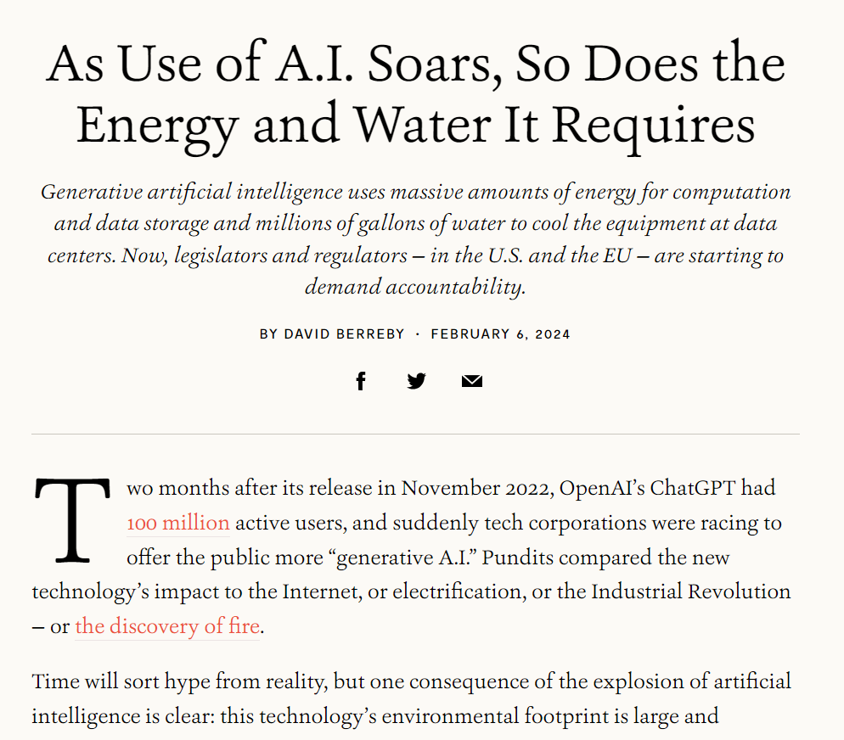
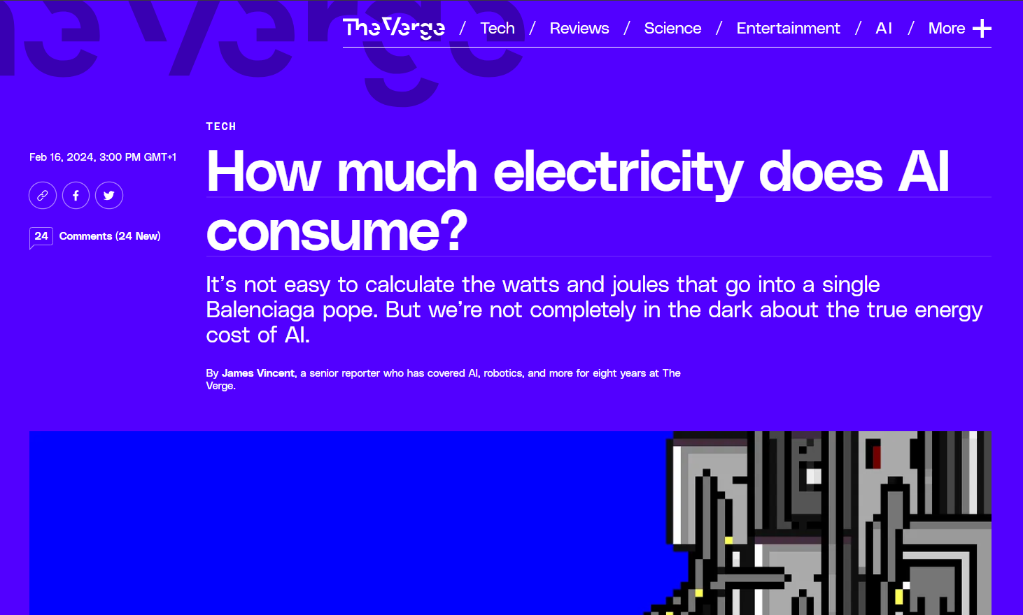
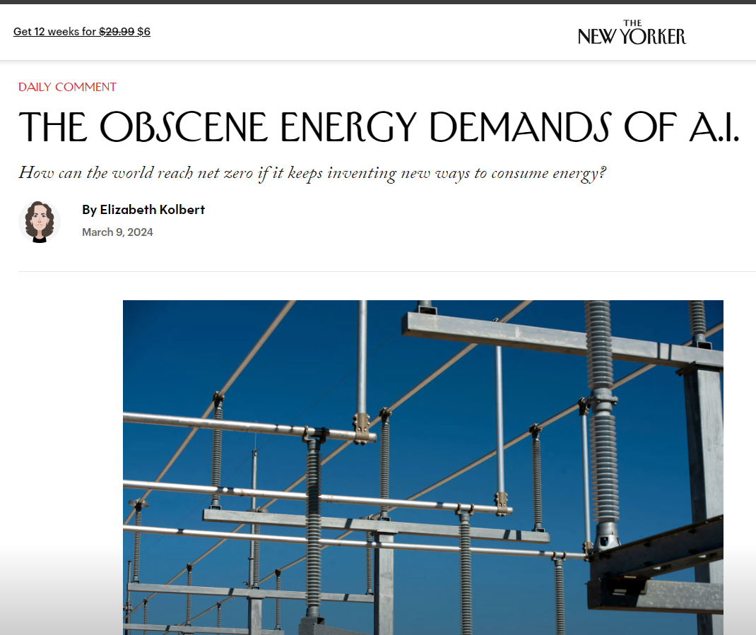
Why this theme?
Notes:
https://e360.yale.edu/features/artificial-intelligence-climate-energy-emissions
https://www.newyorker.com/news/daily-comment/the-obscene-energy-demands-of-ai
https://www.theverge.com/24066646/ai-electricity-energy-watts-generative-consumption
https://spectrum.ieee.org/ai-energy-consumption

Slide 7
Agenda
Day 1: Sunday, June 9
Day 2: Monday, June 10
9:00 - 9:30 CEST - Welcome and coffee 9:30 - 10:30 CEST – Introduction 10:30 – 11:00 CEST – Project and team discovery time 11:00 - 18:00 CEST - Hacking all day
9:00 - 9:15 CEST - Welcome and coffee 9:15 – 12:00 CEST - Hacking 12:00 CEST: CODE FREEZE – Instructions for the next step 12:15-14:00 CEST – Time for working and practicing presentations 14:00 – 15:15 CEST - Presentations to the Judging Panel 15:15 - 15:45 CEST - Announcement of the winners and prizes*

Slide 8


Awards!
There are two awards up for grabs.
These two teams will have their final presentations in the Energy Transition Theatre during the annual meeting!
Best in Show – chosen by a panel of judges
Audience Choice – Chosen by you!

Slide 9

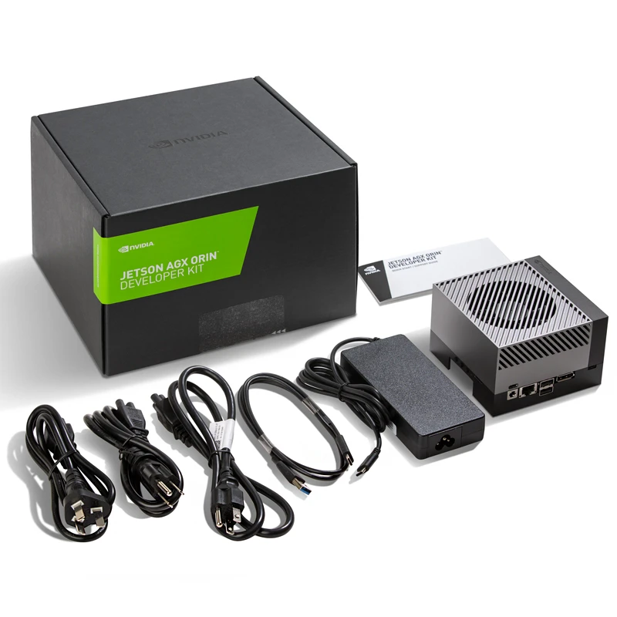
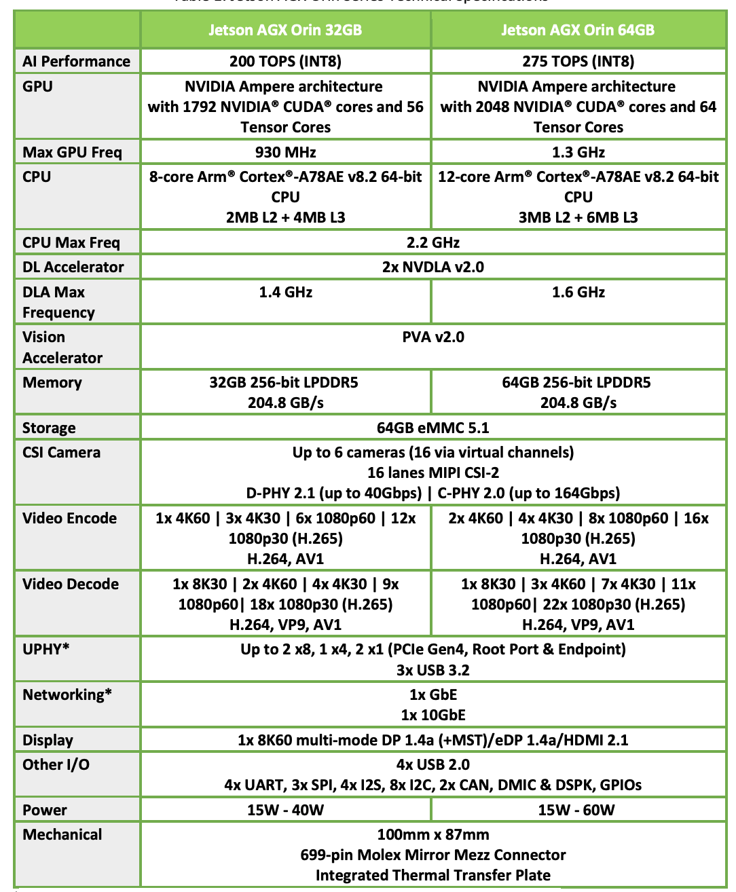
Awards!
NVIDIA Jetson AGX Orin

Slide 10
Github is our main tool during the hack
EAGE – Annual – Hackathon - Discussions

Slide 11
Github Hackathon Instructions
EAGE – Annual – Hackathon - Instructions

Slide 12
Resources can also be found on Github

Slide 13
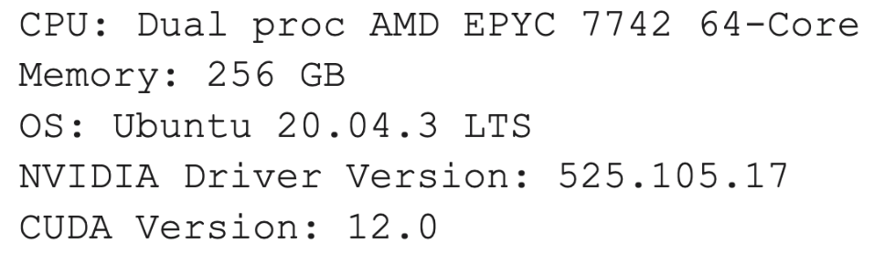
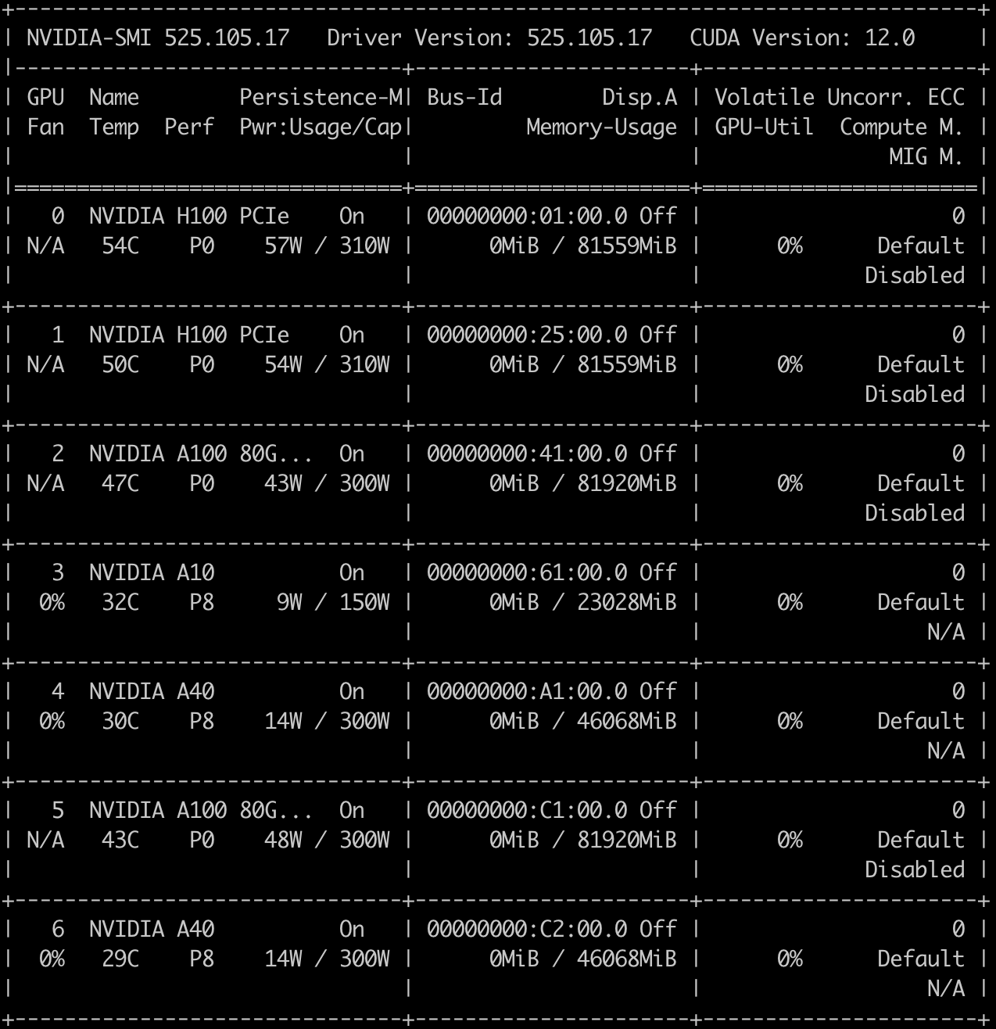
GPU resources
Connect to login node:
ssh you_login@nvpoc.ddnsfree.com
Run interactive session:
srun --gpus N --pty bash -i
NVIDIA Docker Container Repository
https://catalog.ngc.nvidia.com/
Full details:
https://docs.google.com/document/d/1ce94uqAhiggMm9IQvgMElNZiI-T3XDTklsjPcpcv0qA/edit?usp=sharing

Slide 14
Some General Recommendations
Be mindful towards others and yourself.
Ask for help
Interact with other teams
Try to close the loop early: data -> model -> interpretability -> learnings
One key item, is better than 100 half-baked things
Focus on things that will get your idea across
Keep it simple, s**** (KISS)
Get to know your teammates, play into your strengths
Maximize learning, over winning. Learning *is* winning.
Presentation is key and framing to the theme
Dare to go your own way: Every hackathon, project, team, and individual are unique.
Source: Accumulated Hackathon Experience

Slide 15
Some Hackathon Tips
Take screenshots as you go along – this will save a lot of time when you come to preparing the final presentation
A little planning goes a long way – post its to organize your work or making a list can help keep focus. Github Issues is a way to digitally keep track as well.
By the end of the day today you should have settled on a specific case, sketched out a plan, and have started some work.

Slide 16

Reminder: Hackathons aren’t about getting a perfect solution or answer – it is about trying something new, being bold and learning along the way

Slide 17
Hackathon Project Ideas

Slide 18
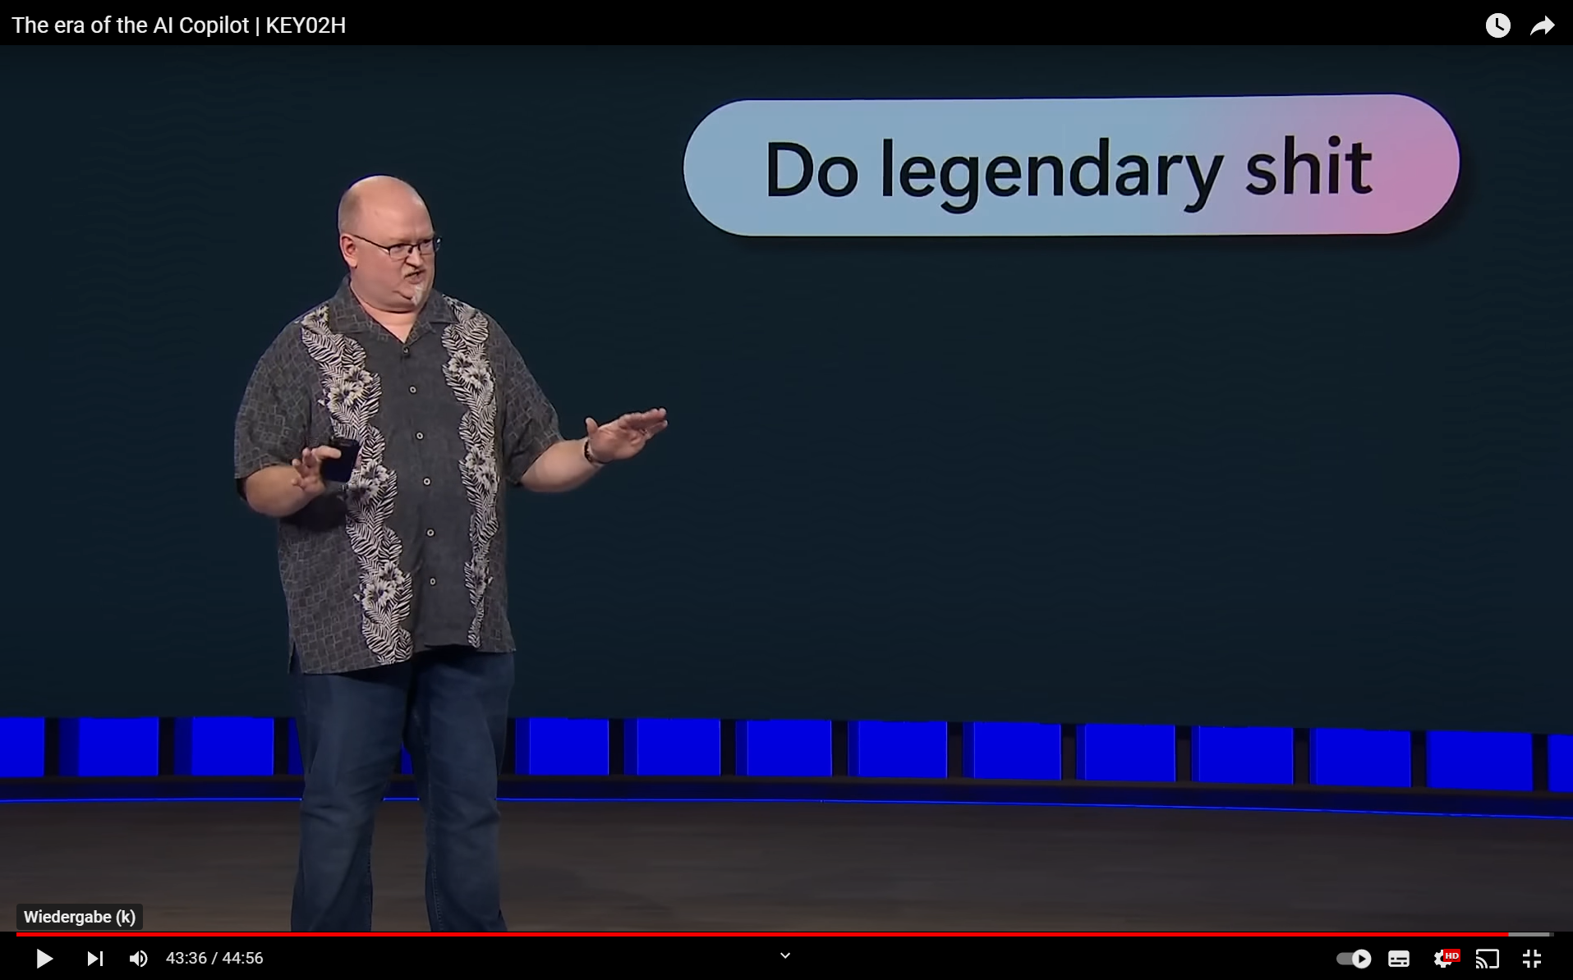

(Title)
(Body)

Slide 19
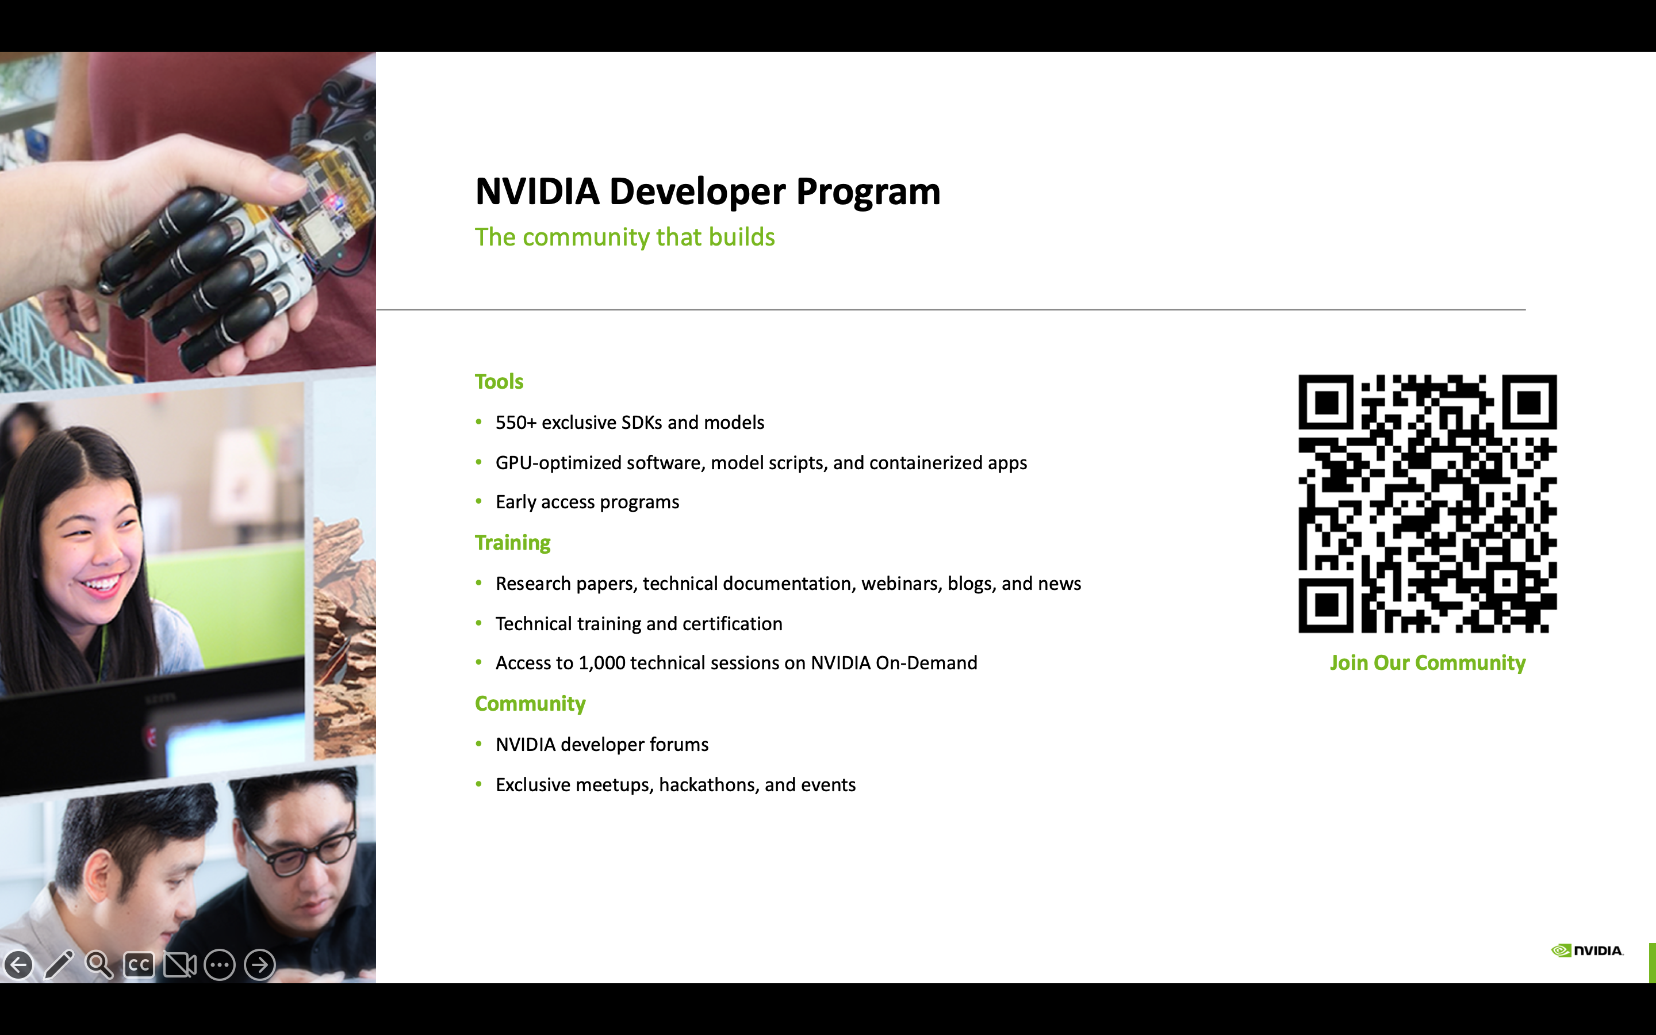

Slide 20
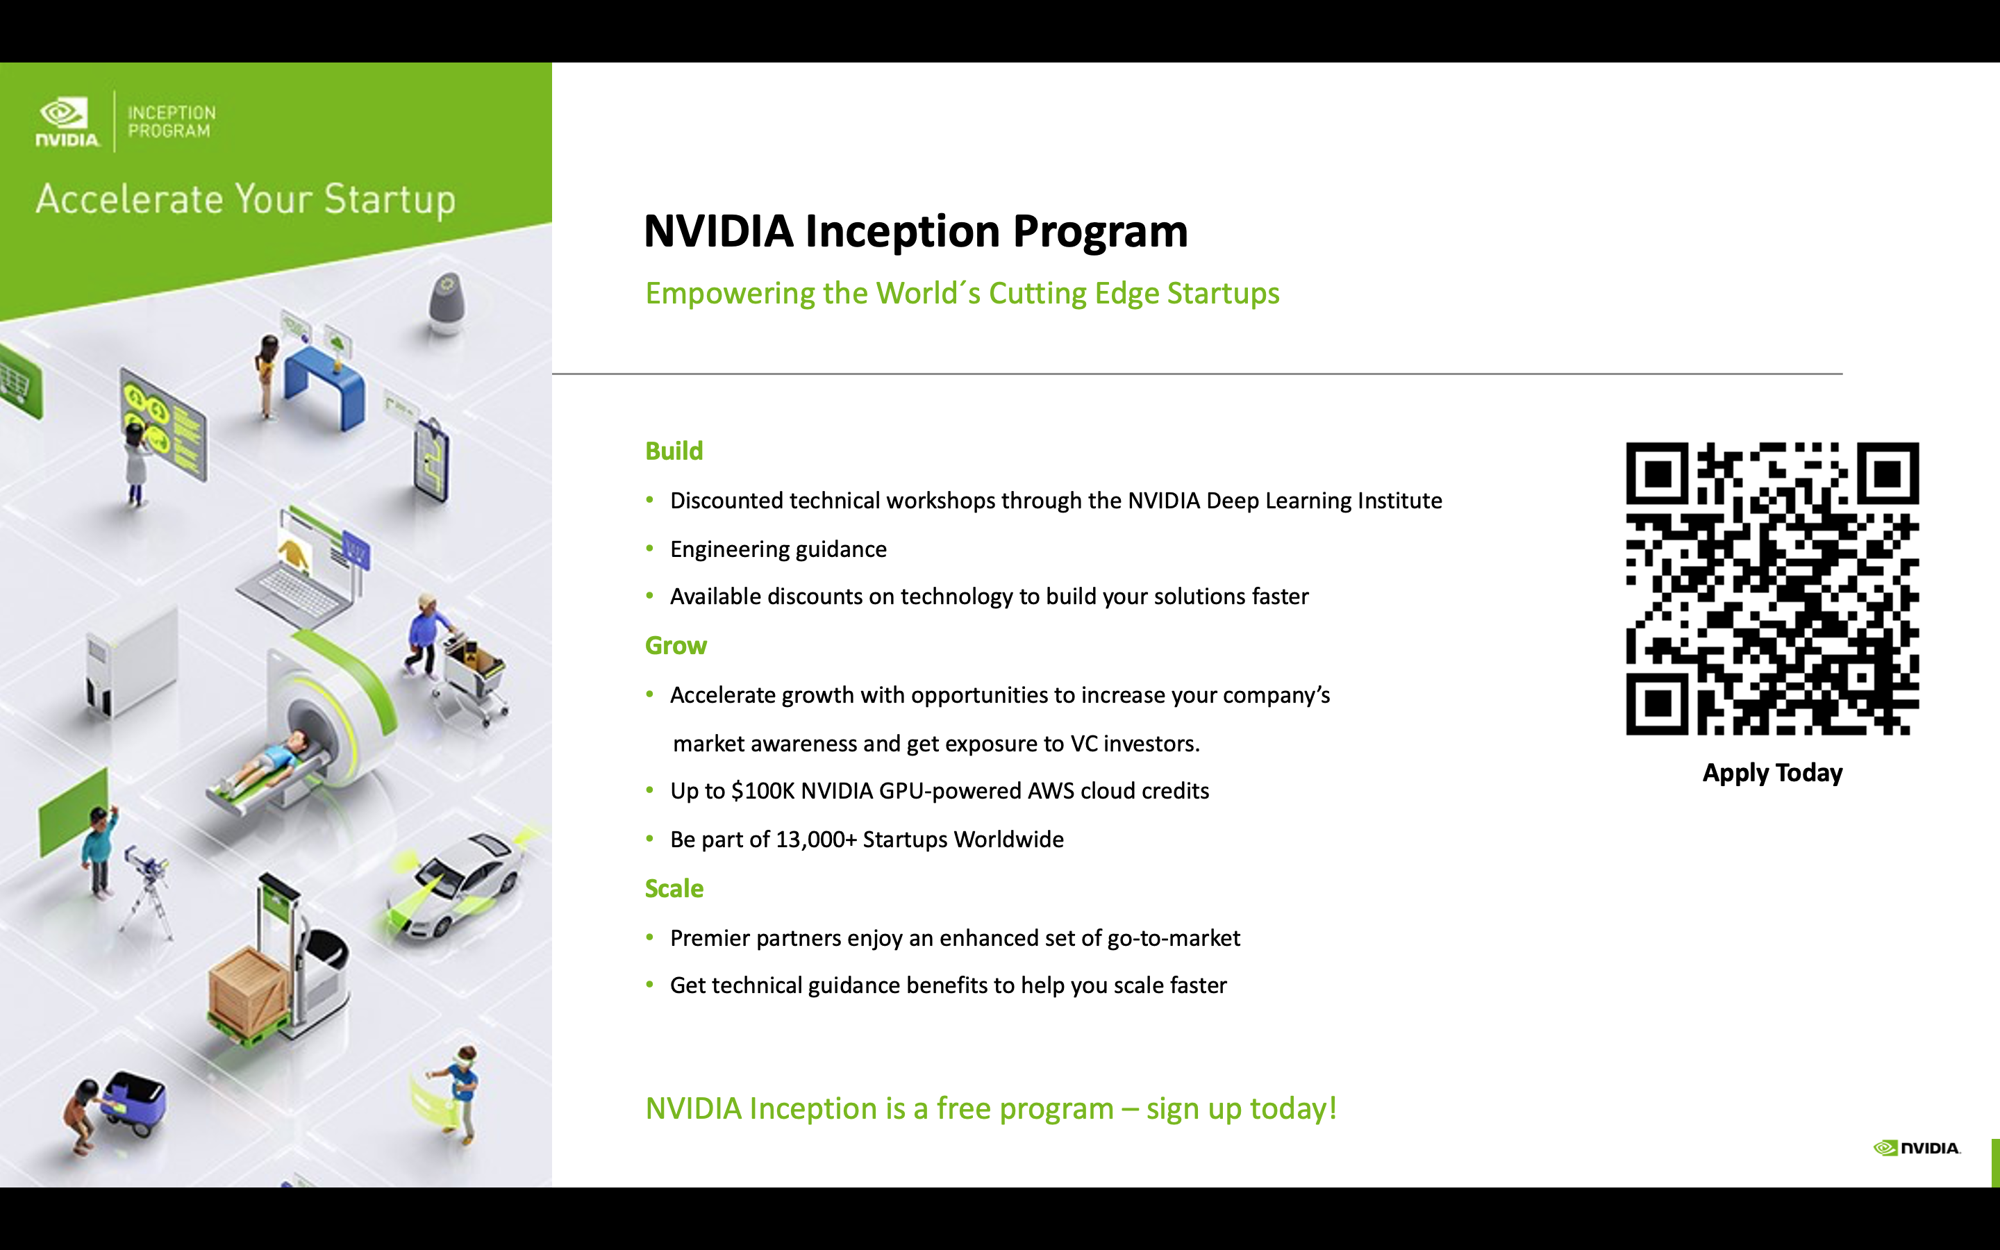

Slide 21
